Slide 1
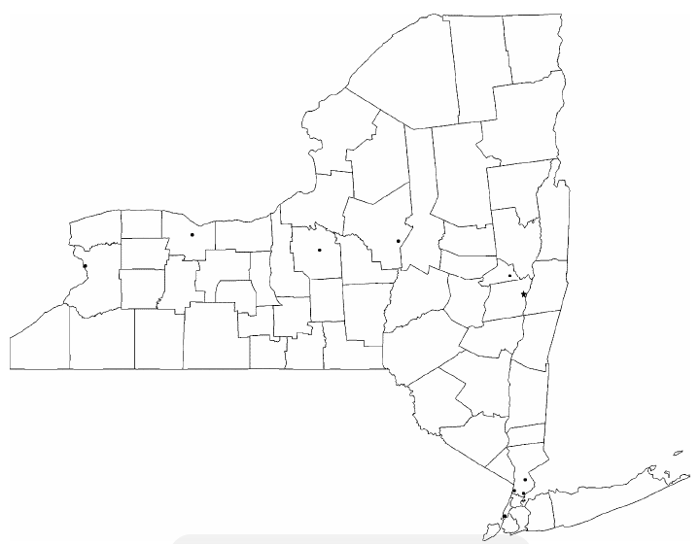
Enclosure 3 (NYS Map of Resources) to Letter of Instruction (LOI) 92-12 – NYARNG Suicide Prevention Stand Down
FT Drum
Watertown
Niagara Falls
Rochester
Syracuse
Batavia
Canandaigua
Latham DMNA
Buffalo
Scotia
Troy
Albany
Bath
Binghamton
Family Program Offices
Castle Point
Newburgh
Active Duty Base
Peekskill
Montrose
Air Wings
Long Island
Bronx
VA Medical Center
New York
Manhattan
Northport
VET Center
Brooklyn
Staten Island
FT Hamilton
Notes:
Key:
Latham DMNA:
Director of Psychological Health Jolene Kent-Stanley 518-786-4956 jolene.kent-stanley@ceridian.com
State Chaplain Chaplain (Col) Eric Olsen 518-891-7435
R3SP 1LT Karen Marotz 518-786-4455 karen.marotz@us.army.mil
Family Assistance Specialist Sandra Schlotter 518-786-0390 sandra.j.schlotter@us.army.mil
Senior Family Readiness Support Asst Stephanie Duell 518-786-4774 stephanie.duell@us.army.mil
Family Readiness Support Assistant Jenna Herdrick 518-786-4656 jenna.m.herdrick.ctr@us.army.mil
Military One Source/JFSAP Alicia Russo 518-786-4976 alicia.russo@militaryonesource.com
Military Life Consultant (Adult) Kelly Young 518-786-4907 kelly.j.young@healthnet.com
Personal Financial Consultant Robert Boram 518-786-0406 robert.boram@mhn.com
Transition Assistance Advisor Gene Murphy 518-786-4678 eugene.a.murphy@us.army.mil
ESGR Bill Tracy 518-786-4911 william.j.tracy@us.army.mil
ESGR John Willsey 518-786-0389 john.j.willsey@us.army.mil
NYNG ESGR Program Coordinator Robert Van Pelt 518-786-4605 robert.w.vanpelt@us.army.mil
Troy Armory:
Family Assistance Specialist Joanne Murphy 518-285-5830 joanne.m.murphy@us.army.mil
Family Readiness Support Assistant Theresa Barone-Lopez 518-285-5848 theresa.baronelopez@us.army.mil
Peekskill Armory:
Family Assistance Specialist Kelly Stroh 914-944-6592 kelly.stroh@us.army.mil
New York Armory:
Family Assistance Specialist Betty Eissfeld 646-424-5555 betty.eissfeld@us.army.mil
Staten Island Armory:
Family Assistance Specialist Amy Maniscalco 718-420-5960 amy.maniscalco@us.army.mil
Long Island Armory:
Family Assistance Specialist Deanna Bullock 631-471-0909 deanna.m.bullock@us.army.mil
Senior Family Readiness Support Asst Laraine Figliuolo 631-471-0909 laraine.figliuolo@us.army.mil
Fort Hamilton:
Family Readiness Support Assistant Suzanne Beaton 347-569-8047 suzanne.beaton@us.army.mil
Syracuse Armory:
Family Assistance Specialist Anne Marie Lara 315-438-3022 annemarie.lara@us.army.mil
Family Readiness Support Assistant Kelly Oram 315-774-0477 kelly.m.oram@us.army.mil
Transition Assistance Advisor Robert Gill 315-438-3046 robert.m.gill@us.army.mil
Rochester Armory:
Family Assistance Specialist Mgr Jeanna Clark 585-783-5310 jeanna.clark@us.army.mil
Family Readiness Support Assistant Bonnie Deiter 585-783-5338 bonnie.deiter@us.army.mil
Buffalo Armory:
Family Assistance Specialist Peter Pilc 716-888-5797 peter.pilc@us.army.mil
Fort Drum:
Behavioral Health Department (BHD) in conjunction with the Fort Drum/Samaritan Behavioral Health Clinic Bldg P36
VA Medical Centers:
Albany, Batavia, Bath, Bronx, Brooklyn, Buffalo, Canandaigua, Castle Point, Montrose, Manhattan, Northport, Syracuse (also has a Behavioral Health Out Patient Clinic)
Vet Centers:
Binghamton, Rochester, Watertown
105th Air Wing Newburgh:
Airman & Family Readiness Managers Jeanne Dion 845-563-2062 jeanne.dion@ang.af.mil
106th Rescue Wing Long Island:
Airman & Family Readiness Managers Lisa D'Agostino 631-723-7133 lisa.dagostino@ang.af.mil
107th Air Wing Niagara Falls:
Airman & Family Readiness Managers Jeanne Goetze 716-236-3411 jeanne.goetze@ang.af.mil
109th Airlift Wing Scotia:
Airman & Family Readiness Assistant TSgt Catharine Schmidt 2357 catharine.schmidt@ang.af.mil
174th Fighter Wing Syracuse:
Airman & Family Readiness Manager SSgt Ben Stafford 315-233-2577 174FW.AFRPM@gmail.com
Joint Deployment Health and Wellness Center 315-233-2577

Slide 2
Latham DMNA:
Director of Psychological Health Jolene Kent-Stanley 518-786-4956 jolene.kent-stanley@ceridian.com
State Chaplain Chaplain (Col) Eric Olsen 518-891-7435
R3SP 1LT Karen Marotz 518-786-4455 karen.marotz@us.army.mil
Family Assistance Specialist Sandra Schlotter 518-786-0390 sandra.j.schlotter@us.army.mil
Senior Family Readiness Support Asst Stephanie Duell 518-786-4774 stephanie.duell@us.army.mil
Family Readiness Support Assistant Jenna Herdrick 518-786-4656 jenna.m.herdrick.ctr@us.army.mil
Military One Source/JFSAP Alicia Russo 518-786-4976 alicia.russo@militaryonesource.com
Military Life Consultant (Adult) Kelly Young 518-786-4907 kelly.j.young@healthnet.com
Personal Financial Consultant Robert Boram 518-786-0406 robert.boram@mhn.com
Transition Assistance Advisor Gene Murphy 518-786-4678 eugene.a.murphy@us.army.mil
ESGR Bill Tracy 518-786-4911 william.j.tracy@us.army.mil
ESGR John Willsey 518-786-0389 john.j.willsey@us.army.mil
NYNG ESGR Program Coordinator Robert Van Pelt 518-786-4605 robert.w.vanpelt@us.army.mil

Slide 3
Troy Armory:
Family Assistance Specialist Joanne Murphy 518-285-5830 joanne.m.murphy@us.army.mil
Family Readiness Support Assistant Theresa Barone-Lopez 518-285-5848 theresa.baronelopez@us.army.mil
Peekskill Armory: Family Assistance Specialist Kelly Stroh 914-944-6592 kelly.stroh@us.army.mil
New York Armory: Family Assistance Specialist Betty Eissfeld 646-424-5555 betty.eissfeld@us.army.mil
Staten Island Armory: Family Assistance Specialist Amy Maniscalco 718-420-5960 amy.maniscalco@us.army.mil
Long Island Armory:
Family Assistance Specialist Deanna Bullock 631-471-0909 deanna.m.bullock@us.army.mil
Senior Family Readiness Support Asst Laraine Figliuolo 631-471-0909 laraine.figliuolo@us.army.mil
Fort Hamilton: Family Readiness Support Assistant Suzanne Beaton 347-569-8047 suzanne.beaton@us.army.mil
Syracuse Armory:
Family Assistance Specialist Anne Marie Lara 315-438-3022 annemarie.lara@us.army.mil
Family Readiness Support Assistant Kelly Oram 315-774-0477 kelly.m.oram@us.army.mil
Transition Assistance Advisor Robert Gill 315-438-3046 robert.m.gill@us.army.mil
Rochester Armory:
Family Assistance Specialist Mgr Jeanna Clark 585-783-5310 jeanna.clark@us.army.mil
Family Readiness Support Assistant Bonnie Deiter 585-783-5338 bonnie.deiter@us.army.mil
Buffalo Armory: Family Assistance Specialist Peter Pilc 716-888-5797 peter.pilc@us.army.mil

Slide 4
Fort Drum: Behavioral Health Department (BHD) in conjunction with the Fort Drum/Samaritan Behavioral Health Clinic Bldg P36
VA Medical Centers: Albany, Batavia, Bath, Bronx, Brooklyn, Buffalo, Canandaigua, Castle Point, Montrose, Manhattan, Northport, Syracuse (also has a Behavioral Health Out Patient Clinic)
Vet Centers: Binghamton, Rochester, Watertown
105th Air Wing Newburgh: Airman & Family Readiness Managers Jeanne Dion 845-563-2062 jeanne.dion@ang.af.mil
106th Rescue Wing Long Island: Airman & Family Readiness Managers Lisa D'Agostino 631-723-7133 lisa.dagostino@ang.af.mil
107th Air Wing Niagara Falls: Airman & Family Readiness Managers Jeanne Goetze 716-236-3411 jeanne.goetze@ang.af.mil
109th Airlift Wing Scotia: Airman & Family Readiness Assistant TSgt Catharine Schmidt 2357 catharine.schmidt@ang.af.mil
174th Fighter Wing Syracuse:
Airman & Family Readiness Manager SSgt Ben Stafford 315-233-2577 174FW.AFRPM@gmail.com
Joint Deployment Health and Wellness Center 315-233-2577

Slide 5
Other Resources
Crisis Hotlines: 800-273-TALK; 800-342-9647; 800-442-HOPE
TRICARE: http://www.tricare.mil/mentalhealth
Veterans Affairs Center: http://www.vetcenter.va.gov/
New York State Office of Mental Health: http://www.omh.ny.gov/
Vets 4 Warriors: http://www.vets4warriors.com/ (1-855-838-8255)
VFW: http://www.vfw.org/
Army OneSource: http://www.myarmyonesource.com
Military Crisis Line: http://www.veteranscrisisline.net/ActiveDuty.aspx
Military OneSource: http://www.militaryonesource.mil/
Family Programs: http://dmna.ny.gov/family/famredi.php (1-877-715-7817)
Veterans Crisis Line: http://www.veteranscrisisline.net/
National Suicide Prevention Lifeline:
http://www.suicidepreventionlifeline.org/
American Association of Suicidology: http://training.sprc.org/
LivingWorks Education: http://www.livingworks.net/

